Slide 1
Shorten
Repeat
No PCA
More classes
uniformly distributed
conv1d(?)
High recall???
It’s on same dataset

Slide 2
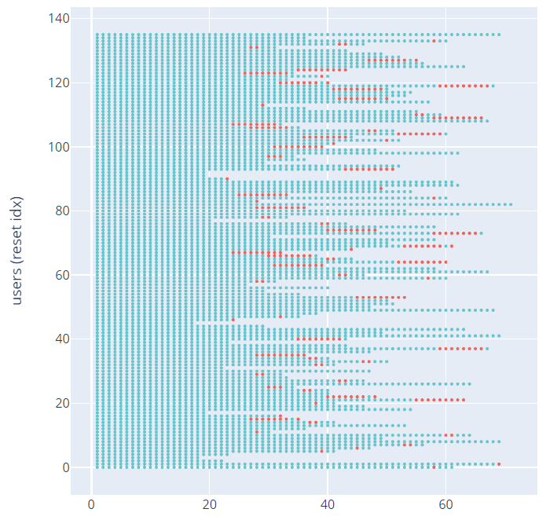
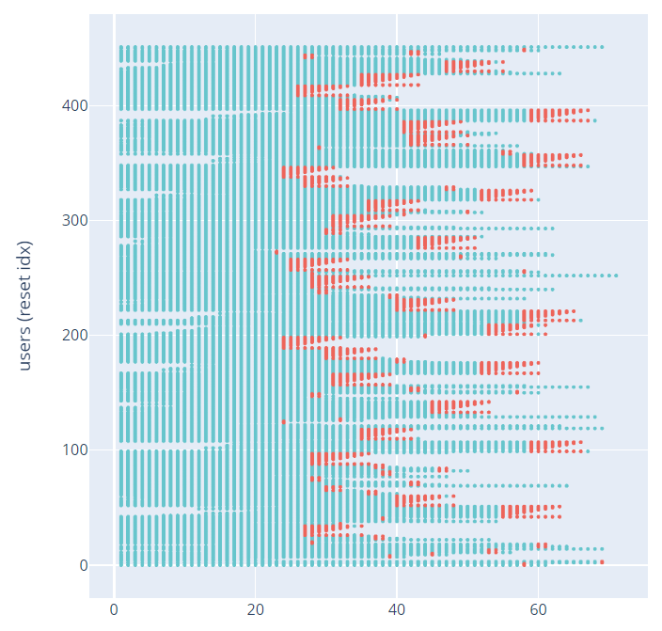
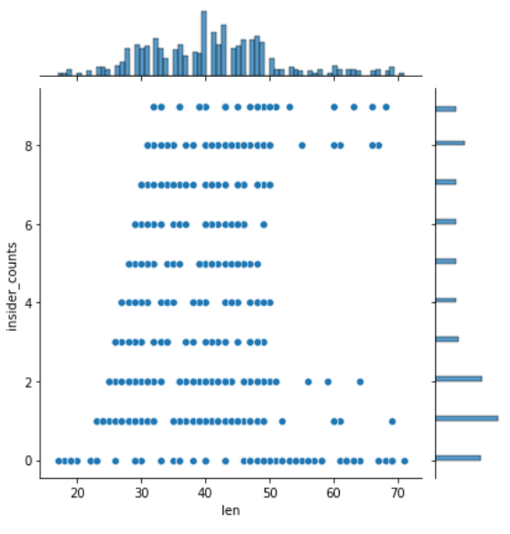

Slide 3
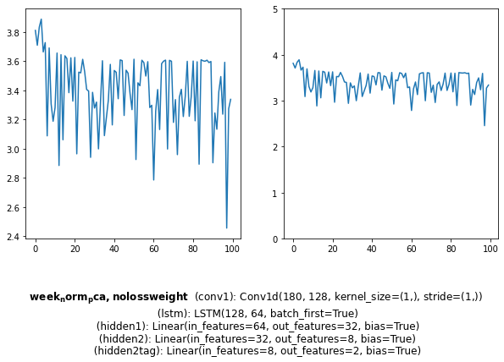
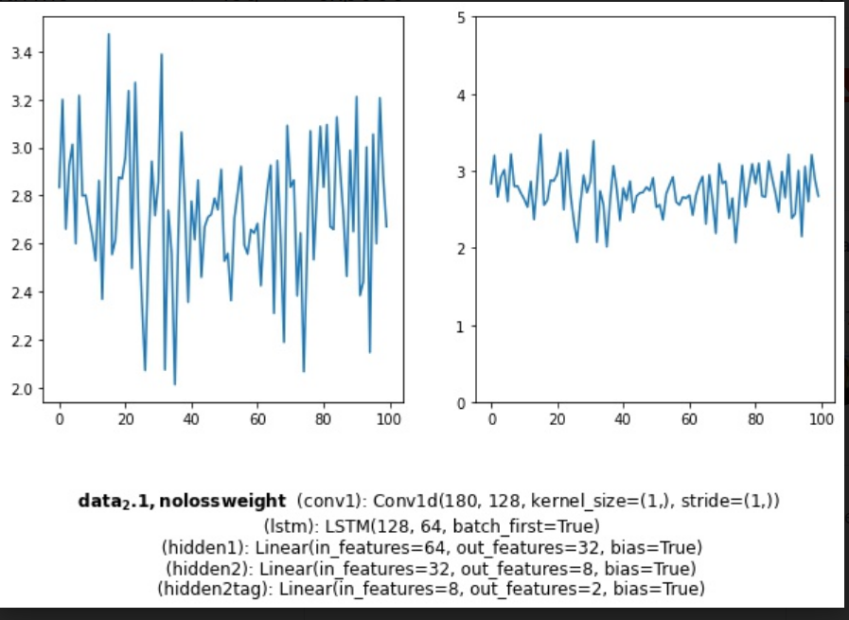
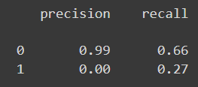
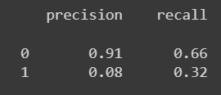

Slide 4
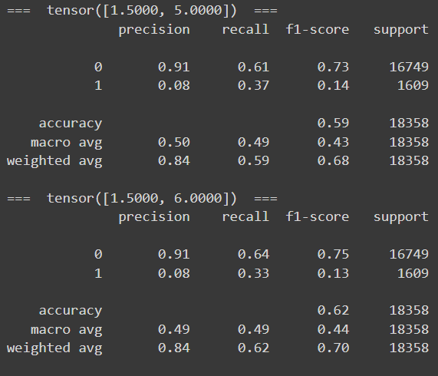
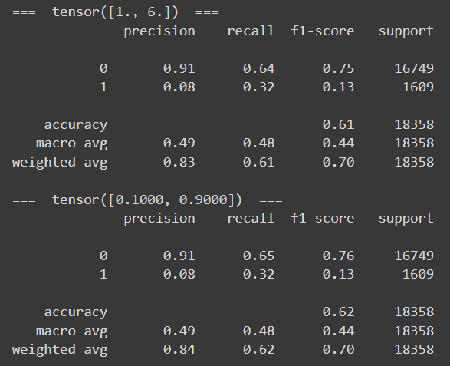
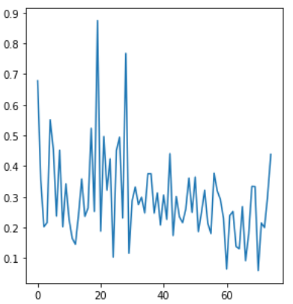
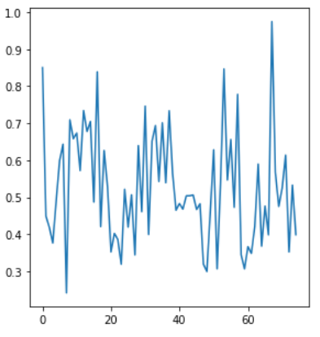
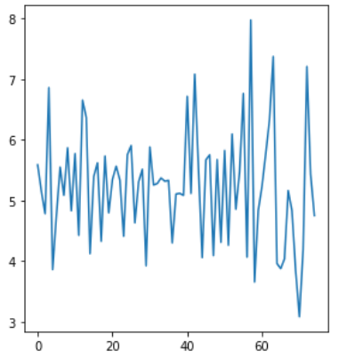
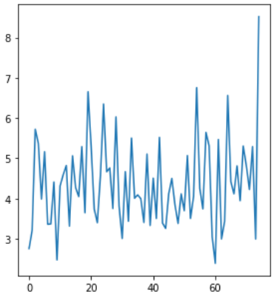
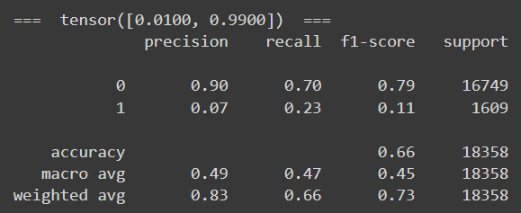
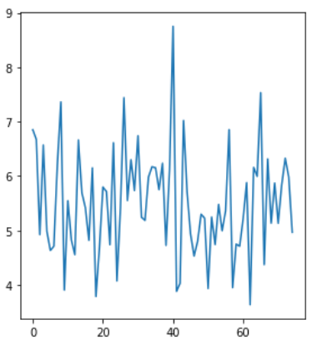

Slide 5
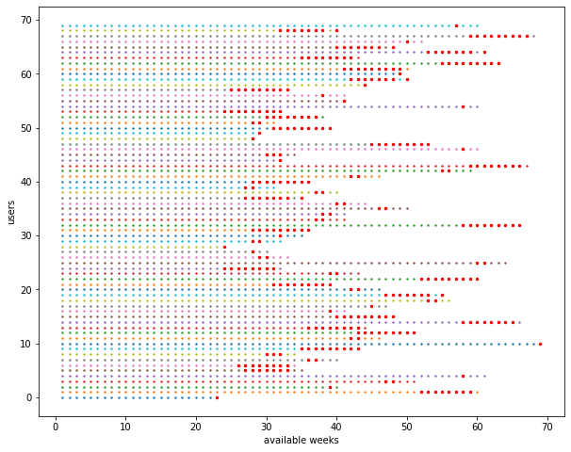
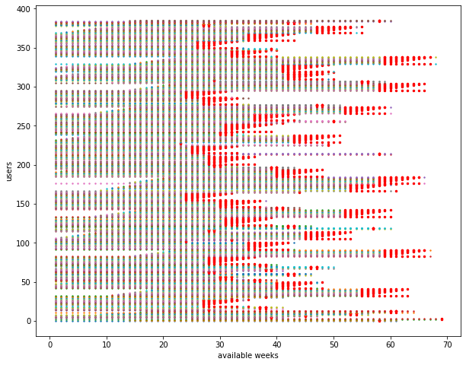
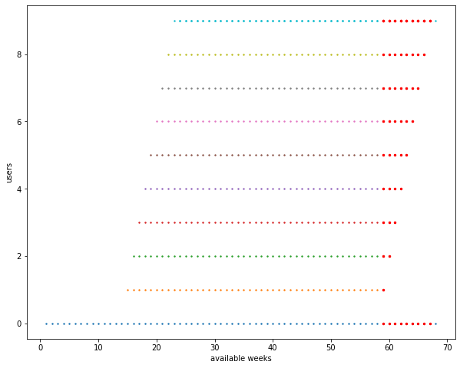
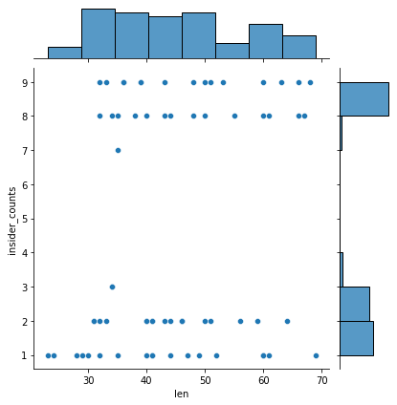
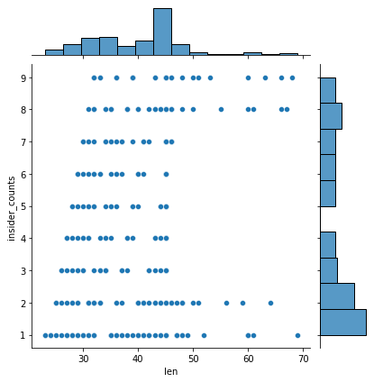
70 users → 386 users

Slide 6
PCA
Weighted loss
Oversampling
Data augmentation
Time related information

Slide 7
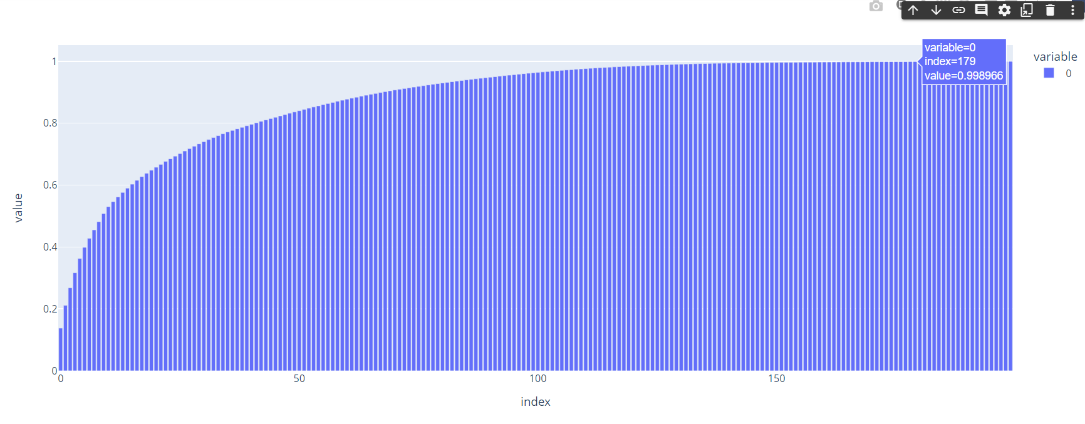
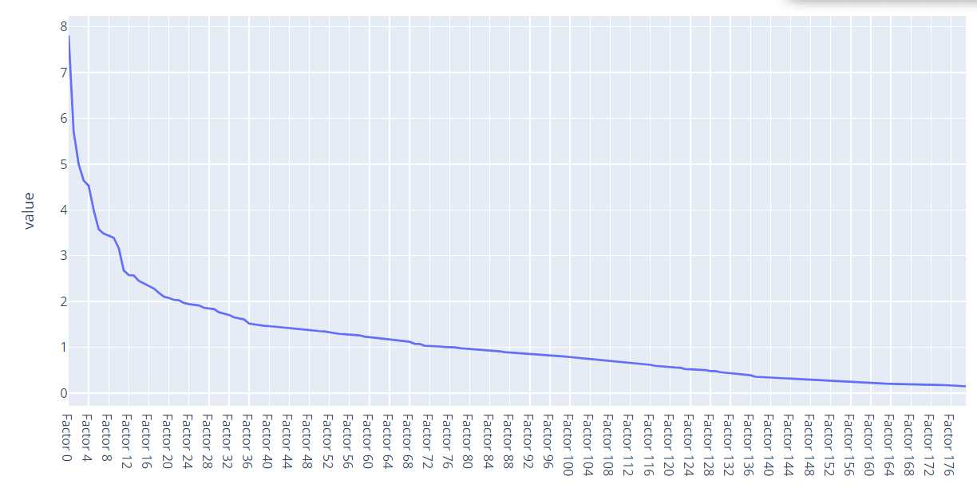
PCA
df_pca.shape: 180 features+1 label * 67166 activities

Slide 8
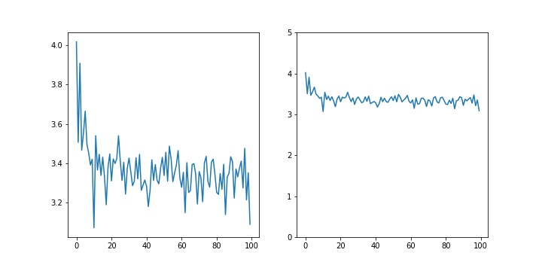
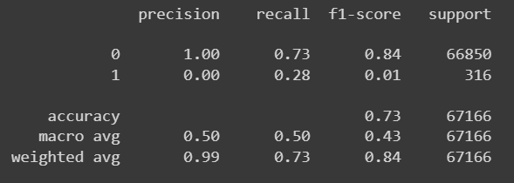
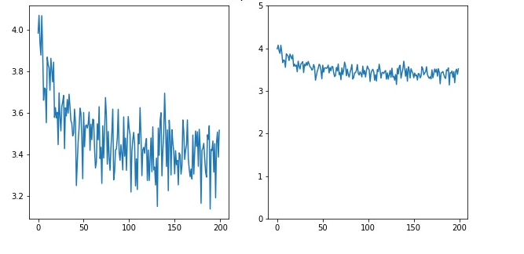
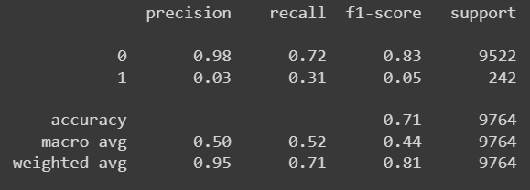
PCA
Loss on data after
Normalization, PCA
LSTM(128)Hidden(32)-Hidden(8)-(2)
Loss on data after
Normalization
LSTM(16)-(2)

Slide 9
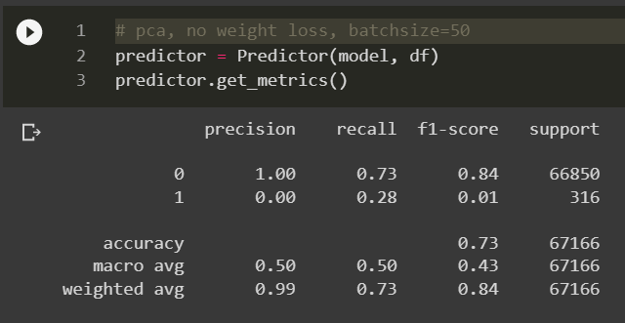
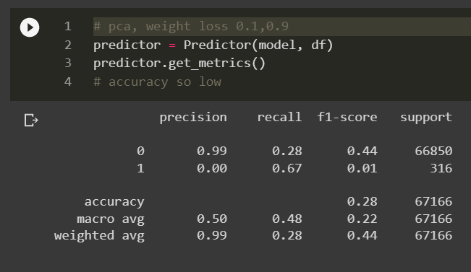
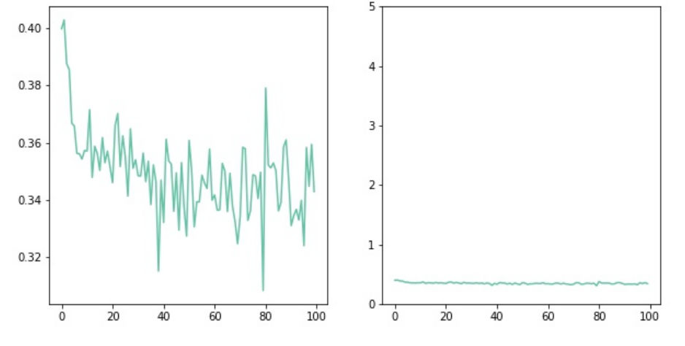
PCA - weighted loss
Notes:
Check difference between test samples, from both model/ in pca feature space
Smaller architecture, fewer features

Slide 10
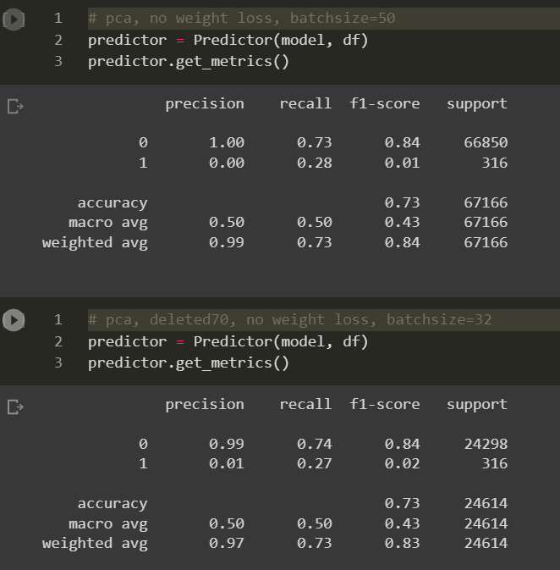
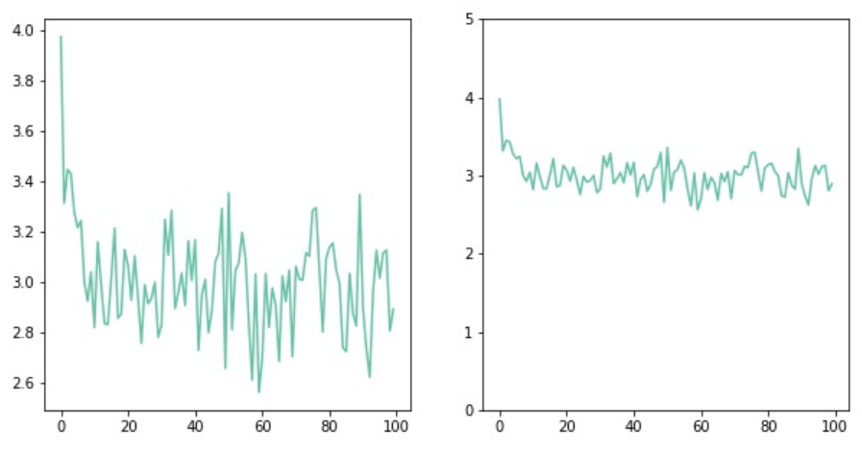
2. Oversampling
Just delete 70%

Slide 11
2. Oversampling - time series?
Simply delete 70%
DBSCAN/KMeans
delete similar users, extract about 10% of the clean users
AE + cos similarity
time series → small vector → similarity
Lp Euclidean distance
Pearson correlation coefficient
DTW Dynamic Time Warping
Input time series 1 label
t1
t2
…
t71
t72
1
0
…
0
0
* 1000

Slide 12
PCA
Weighted loss
Oversampling
Data augmentation
Time related information

Slide 14
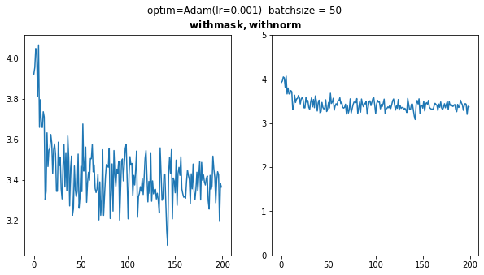
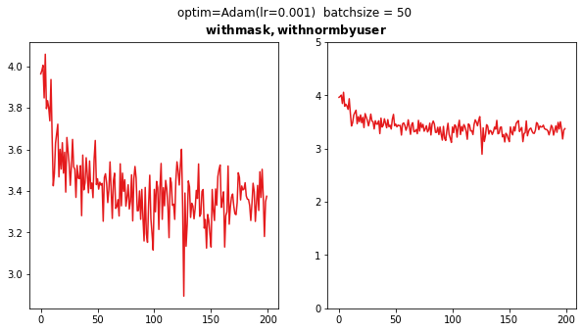
Added masks
Normalization
By features By user By features
Features that has std=0: set to 0

Slide 15
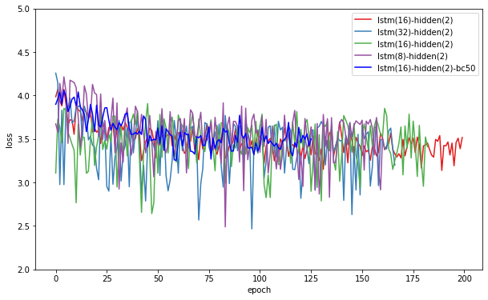
Next: Sampling & Grid Search

Slide 16
Next: Adding Conv, Dense; Change Loss,

Slide 17
Normalization
By features By user By features
Features that has std=0: set to 0

Slide 18
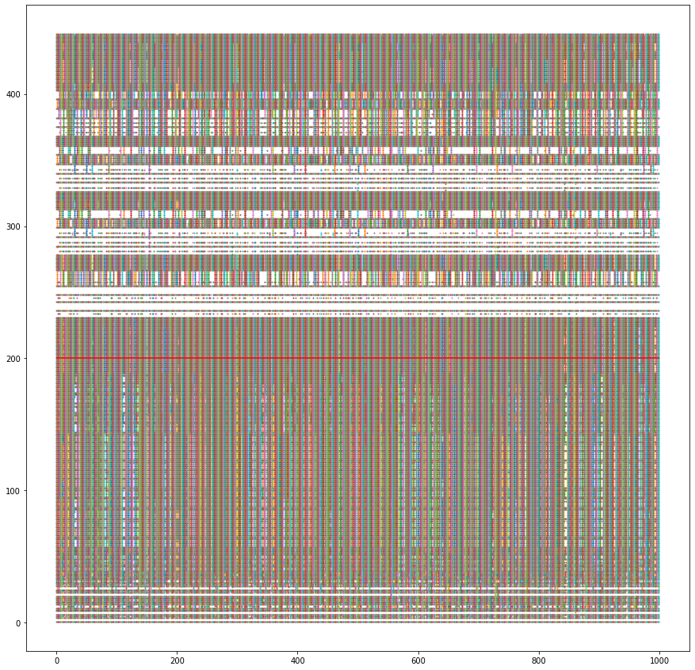
Delete Constant Features
On whole dataset: deleted 200+ cols
By user (i.e. Each input time series):
Each user’s activities has 100~300 constant features
But the intersection is small - 10 cols
Many features are almost constant
only change on few activities
↑ which are not insider

Slide 19
Features that don’t change
Features
(0~447)
Users (0~999)

